Slide 1
ADC - Successive Approximation

Slide 2
ADC - Uses
The most commonly used ADCs are successive approximation and the integrator type.
The successive approximation ADCs are used in applications such as data loggers and instrumentation where conversion speed is important.
The successive approximation and comparator type are faster but less accurate than integrating type converters.
The flash (comparator) type is expensive for high degree of accuracy.
The integrating type converter is used in applications such as digital meter, panel meter and monitoring systems where the conversion accuracy is critical.

Slide 3
Successive Approximation ADC
It has a very special counter circuit known as a successive-approximation register.
Instead of counting up in binary sequence, this register counts by trying all values of bits starting with the most-significant bit and finishing at the least-significant bit.
The register monitors the comparator's output to see if the binary count is less than or greater than the analog signal input, adjusting the bit values accordingly.
Very efficient code search strategy to complete n-bit conversion in just n-clock periods.

Slide 4
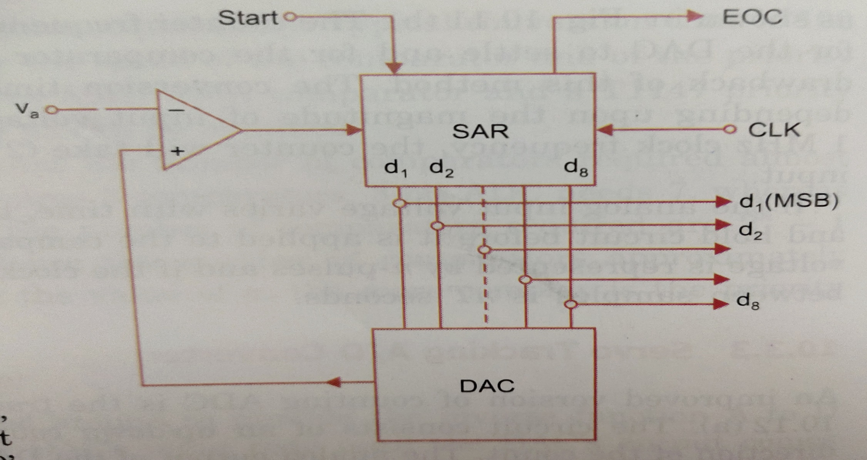
Fundamental diagram of Successive Approximation ADC

Slide 5
Successive Approximation ADC…
The circuit uses a successive approximation register (SAR) to find the required value of each bit by trial and error.
CIRCUIT OPERATION
With the arrival of the START command, the SAR sets the MSB d₁ = 1 with all other bits to zero so that the trial code is 10000000.
The output V_{d} of the DAC is now compared with analog input V_{a}.
If V_{a} is greater than the DAC output V_{d} then 10000000 is less than the correct digital representation. The MSB is left at `1' and the next lower significant bit is made `1‘.
If V_{a} is less than the DAC output, then 10000000 is greater than the correct digital representation. So reset MSB to `0' and go on to the next lower significant bit. This procedure is repeated for all subsequent bits, one at a time .

Slide 6
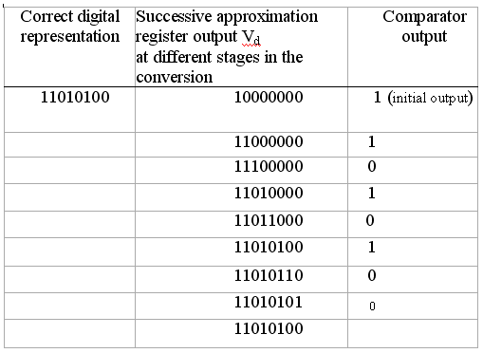
Successive Approximation Converter…
Whenever the DAC output crosses V_{a}, the comparator changes state and this can be taken as the end of conversion (EOC) command.
Tabulation shows a typical conversion sequence

Slide 7
Successive Approximation Converter…
4-bit converter
Assume input is 13 V.
MSB is ‘1’, remaining bits are ‘0’
1000 in binary = 8, compare 13 and 8, 13 > 8.
So retain MSB as ‘1’, set next bit as ‘1’, now the 4-bit word is 1100.
1100 in binary = 12, compare 13 and 12, 13 > 12.
Retain first 2 MS bits as11, set next bit as ‘1’, now the 4-bit word is 1110.
1110 in binary = 14, compare 13 and 14, 13 < 14.
So reset the 3rd bit to ‘0’, set next bit as ‘1’, now the 4-bit word is 1101.
1101 in binary = 13, compare 13 and 13. 13 = 13.
Final output is ‘1101’

Slide 8
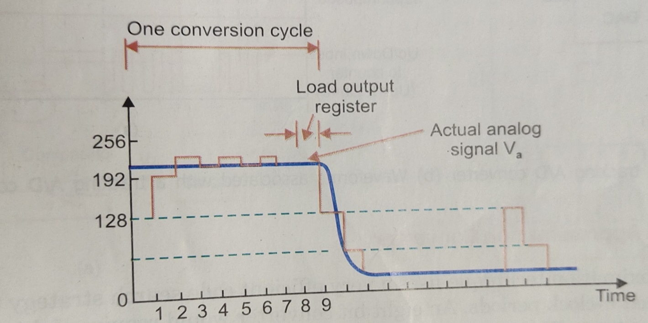
Successive Approximation Converter…
Fig. shows conversion sequence wave forms.
The DAC o/p becomes successively closer to the actual analog i/p voltage.
It requires 8 pulses to establish the accurate output.
One additional clock pulse is used to load the output register and reinitialize the circuit.

